Slide 1
Responding to Injustice
Grades 9 –12
Presentation Slides

Slide 2
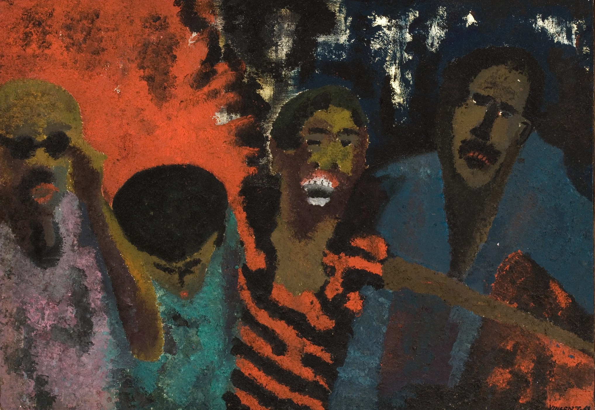

Slide 3
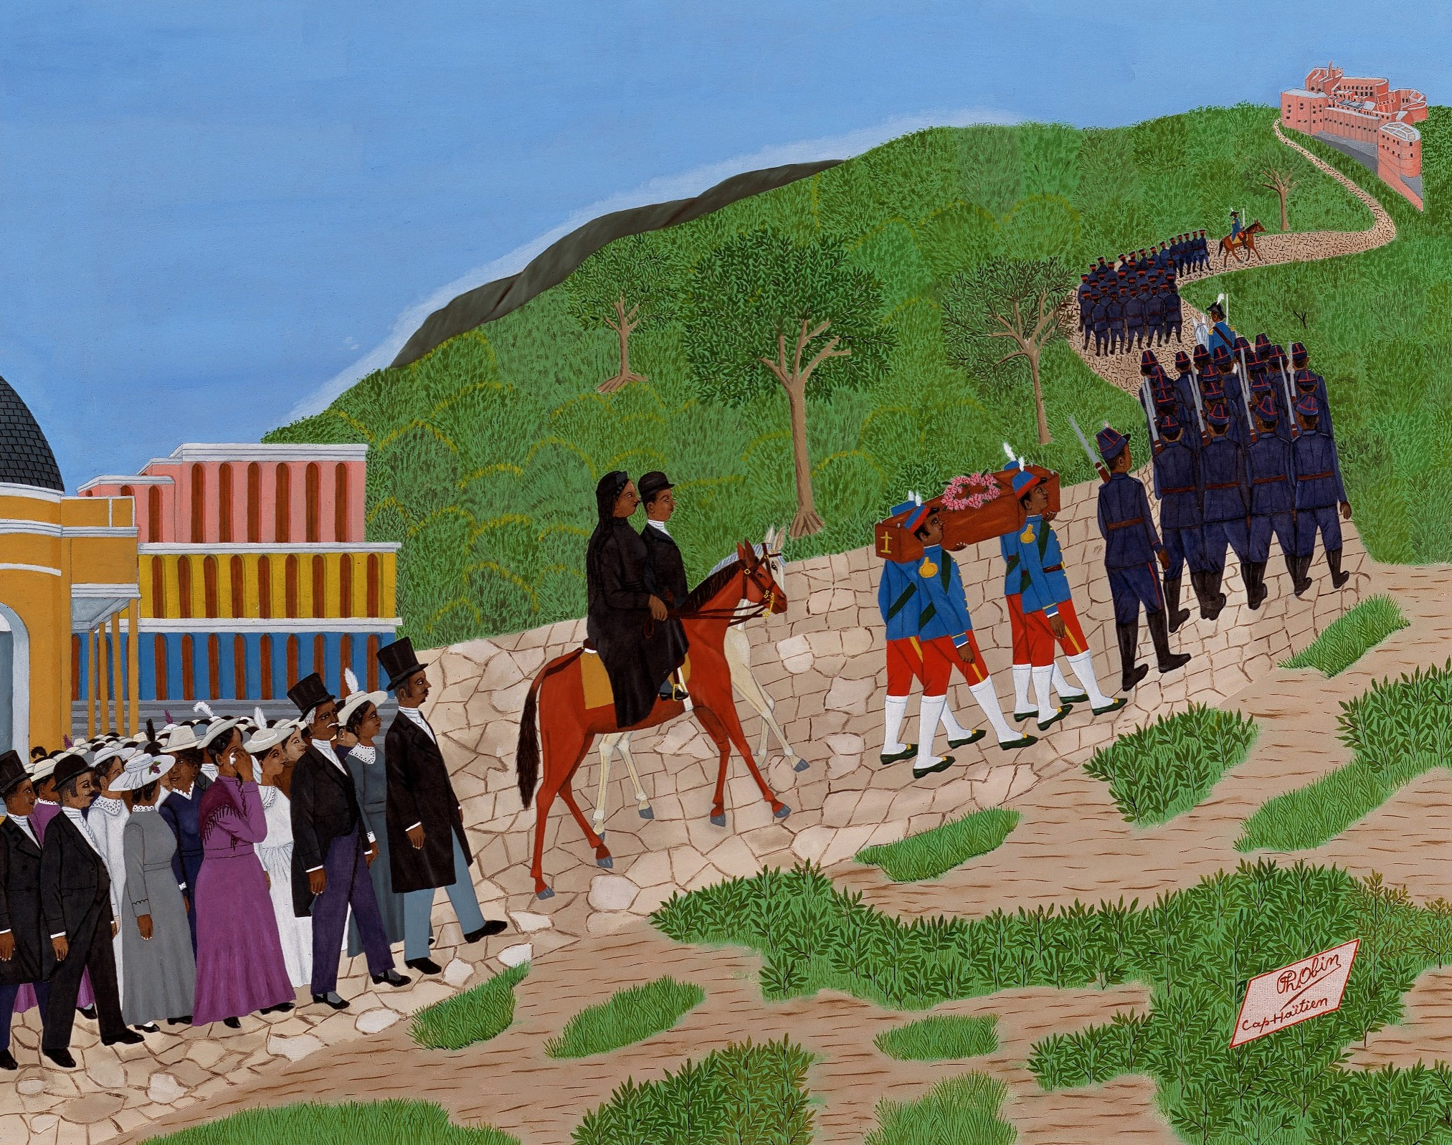

Slide 4
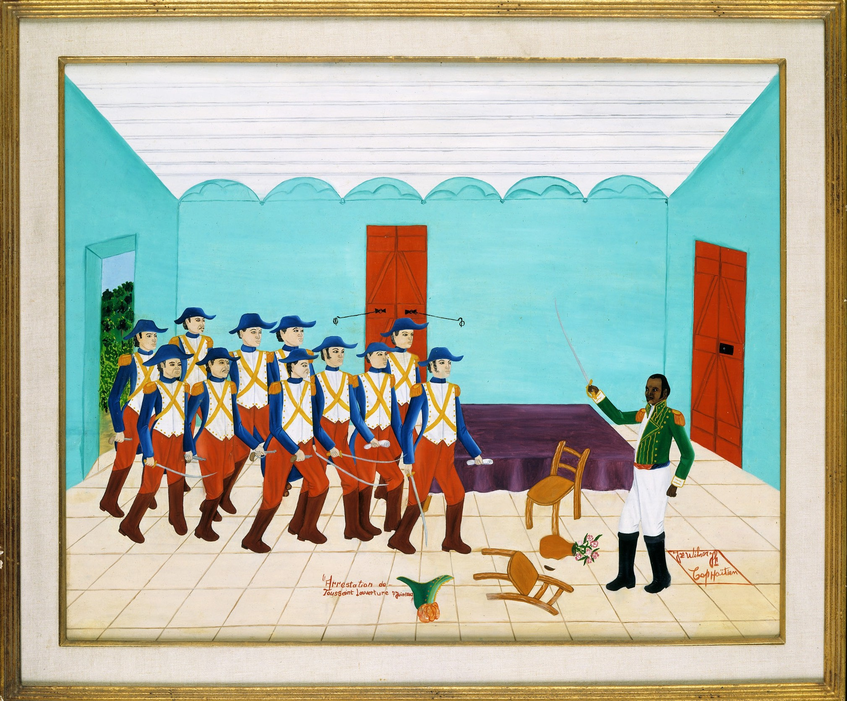

Slide 5

Credits
Slide 2: Vincent Smith, The Fire Next Time, 1968. Detroit Institute of Arts, Museum Purchase,
W. Hawkins Ferry Fund
Slide 3: Philome Obin, The Procession to the Citadel, 1977. Detroit Institute of Arts, Gift of Richard and Alison Jones
Slide 4: Jean Wilner, Arrest of Toussaint Louverture, June 7, 1802, 1971. Detroit Institute of Arts, Gift of anonymous donor

