Slide 1
The Life and Times of Robert S. Duncanson
Presentation Slides

Slide 2
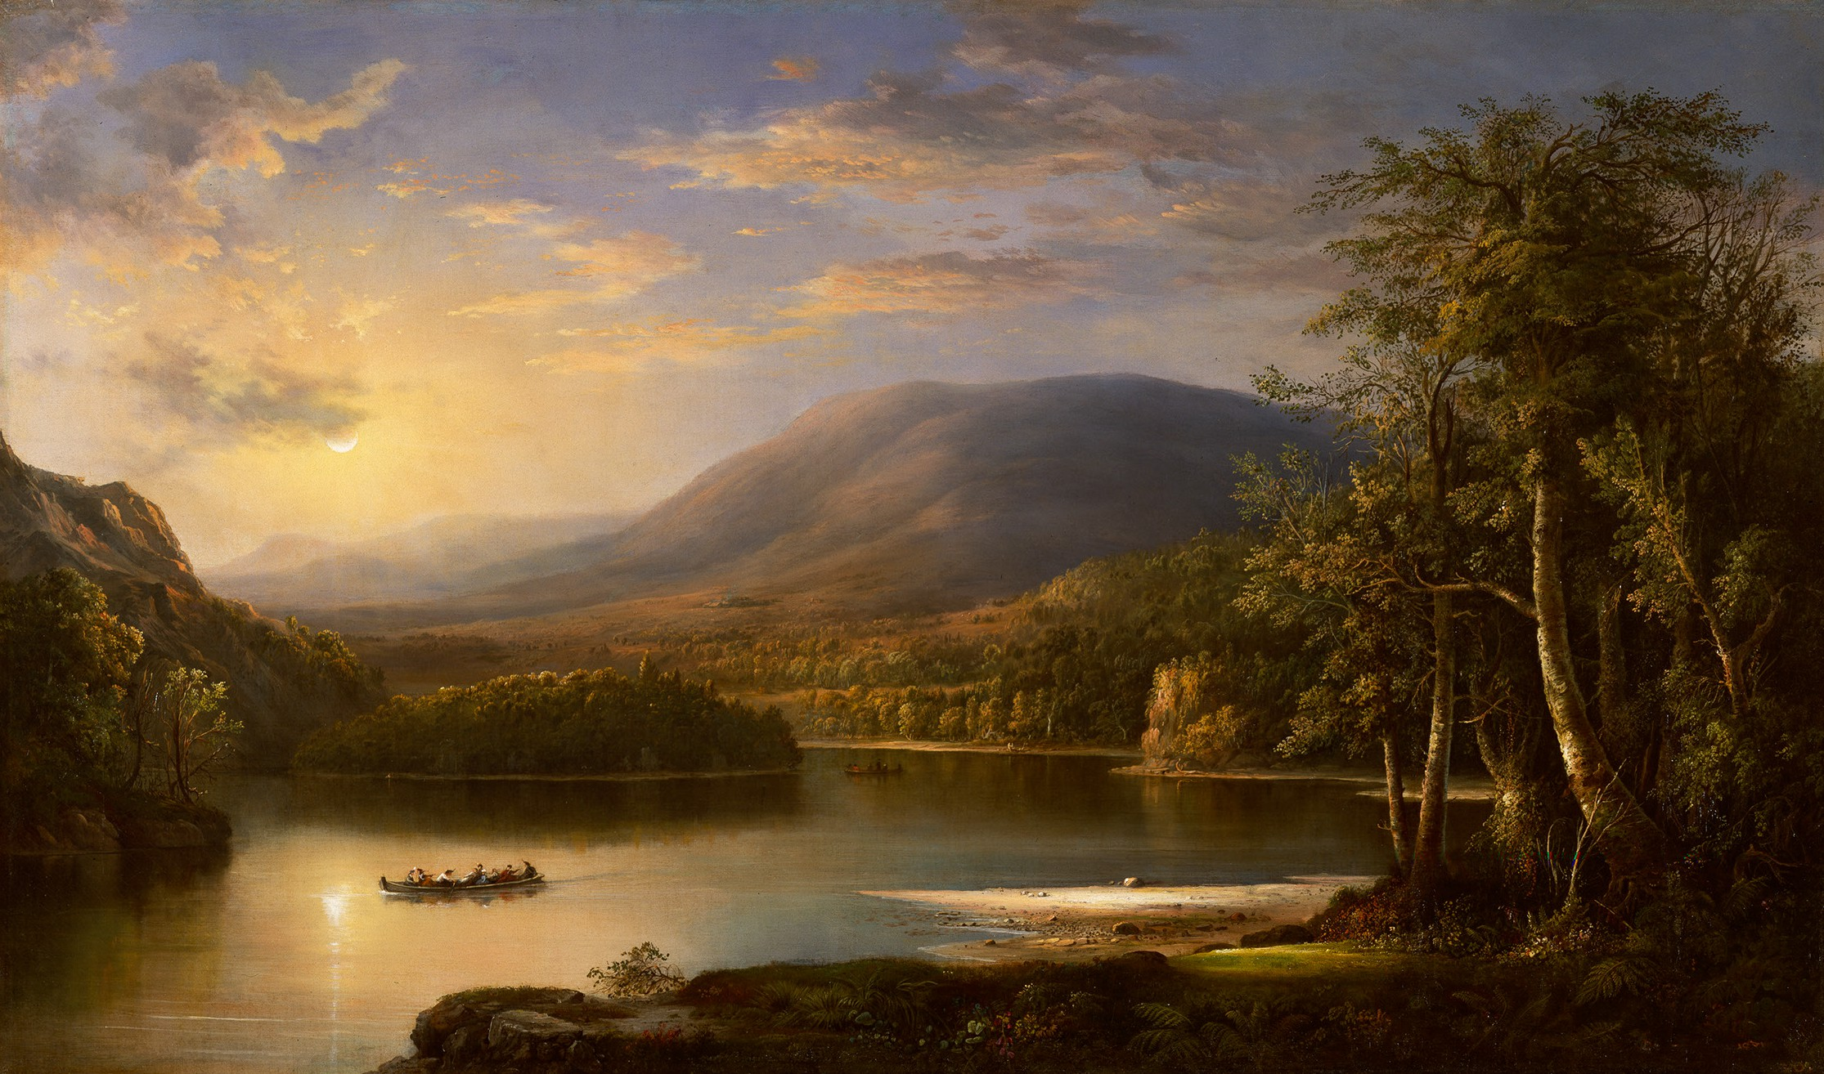

Slide 3

Vocabulary
Abolitionist: a person who worked to end slavery
Emerging: something just starting to come out or be seen
Landscape: An artwork that shows a natural setting and landforms, such as lakes or mountains
Still Life: An artwork of carefully placed non-living objects. (Objects can be natural, such as a bowl of fruit or a vase of flowers, or human-made, like books)

Slide 4
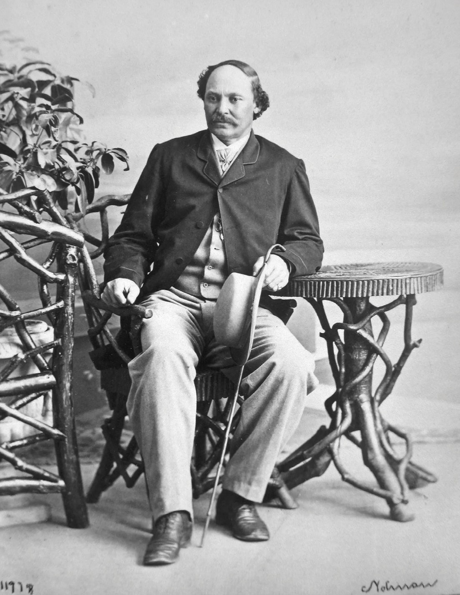
Robert S. Duncanson Biography

Slide 5
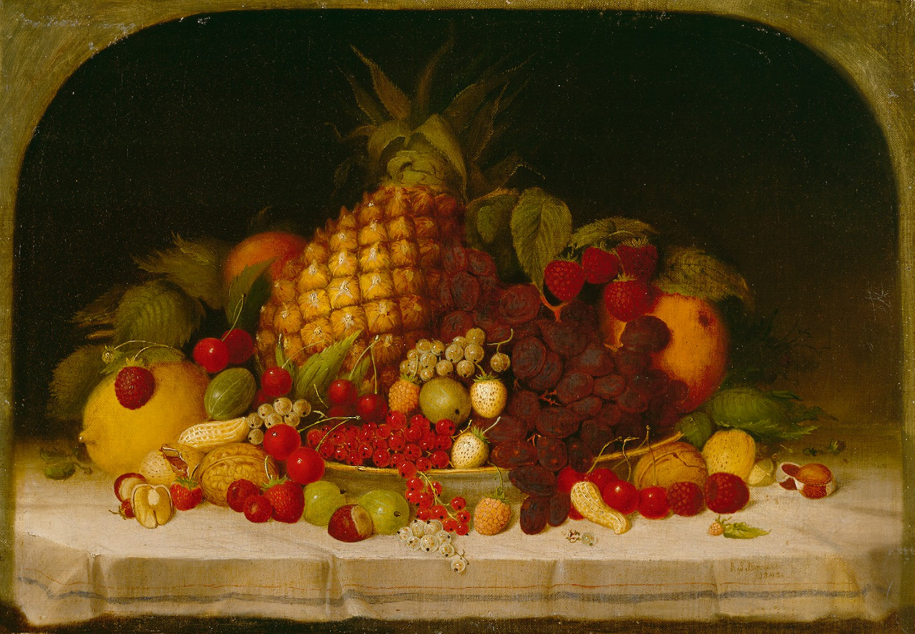
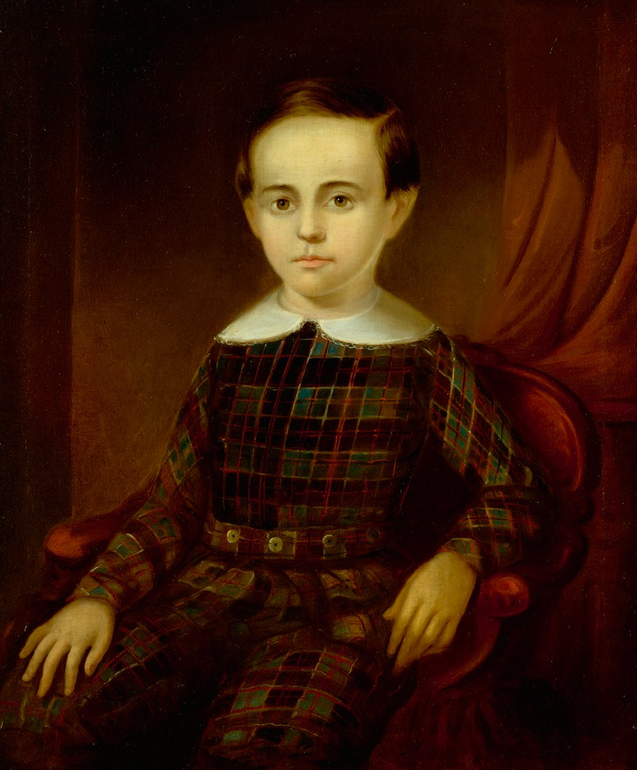
Portrait
Still Life

Slide 6
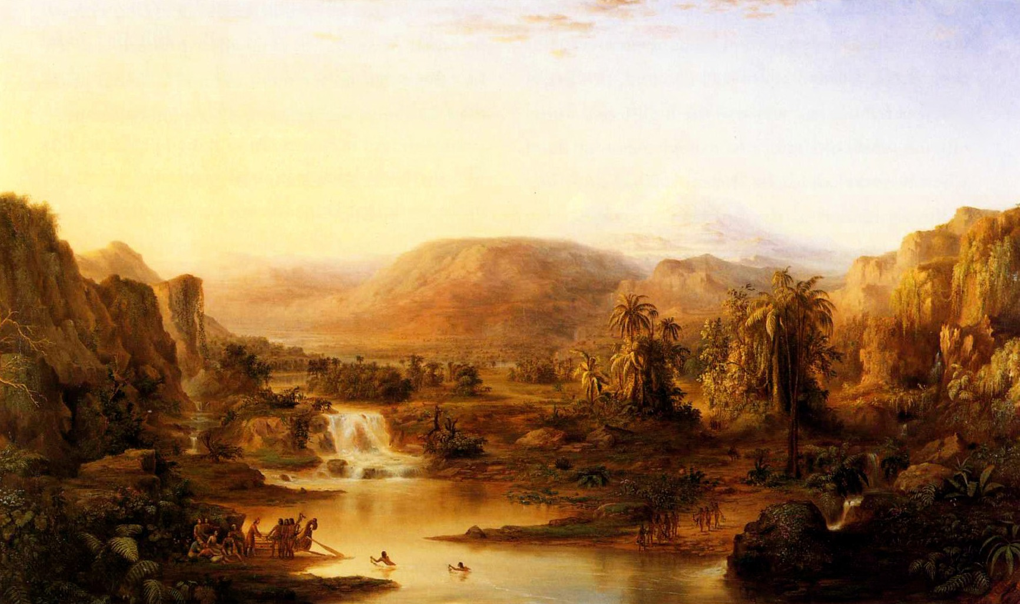

Slide 7
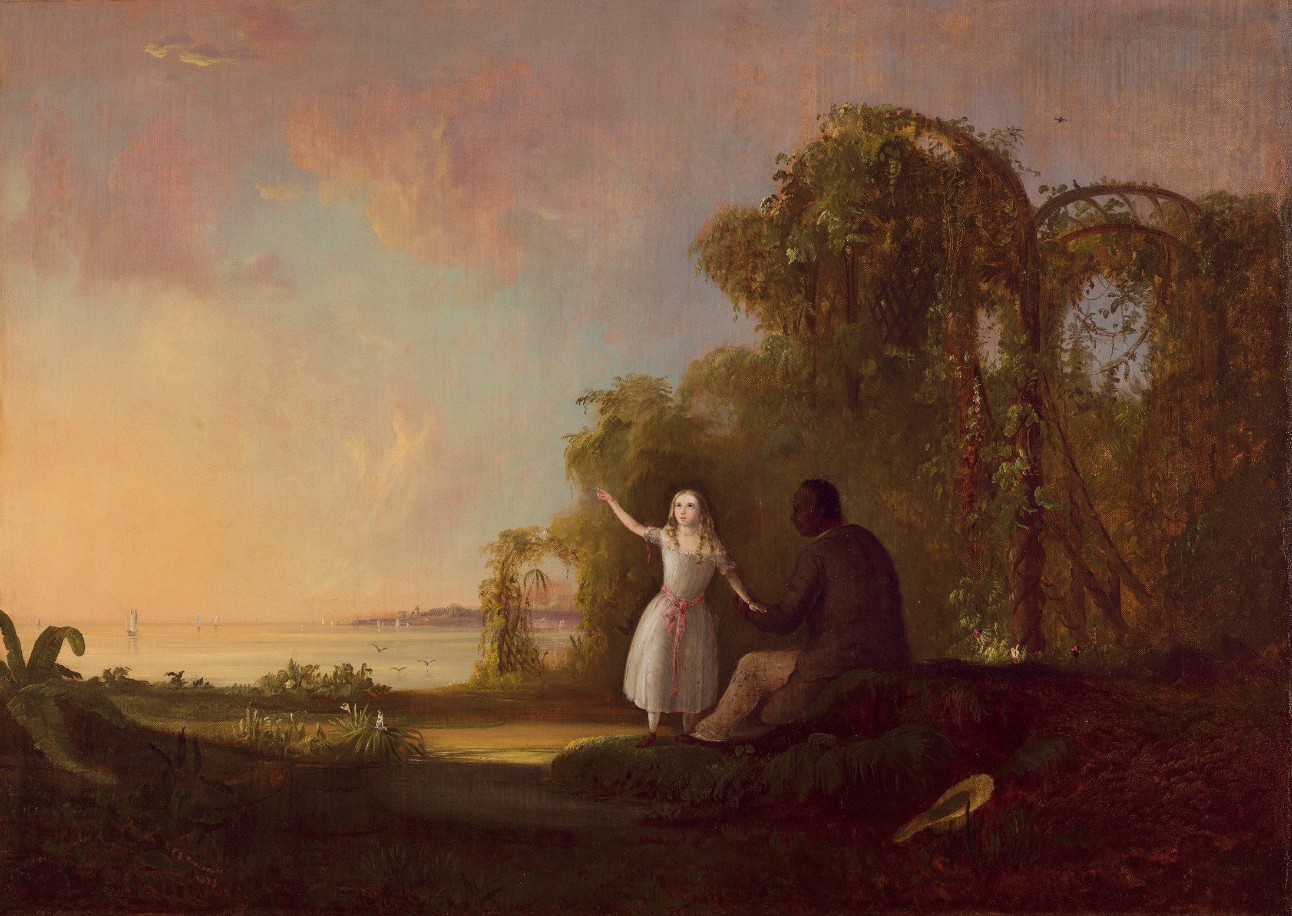

Slide 9
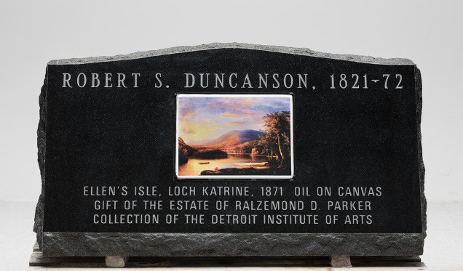

Slide 10
Credits
Slide 2: Robert S. Duncanson, Ellen’s Isle, Loch Katrine, 1871. Detroit Institute of Arts, Gift of the Estate of Ralzemond D. Parker
Slide 4: William Notman, 1864. Courtesy: The McCord Museum (Detroit Free Press)
Slide 5: (left) Robert S. Duncanson, Fruit Piece, 1849. Detroit Institute of Arts, Gift of the Estates of Miss Elizabeth Gray Walker and Mr. Henry Lyster Walker
Slide 5: (right) Robert S. Duncanson, William Berthelet, 1846. Detroit Institute of Arts, Gift of William T. Berthelet
Slide 6: Robert S. Duncanson, Land of the Lotus Eaters, 1861. Courtesy: Swedish Royal Collection, Stockholm
Slide 7: Robert S. Duncanson, Uncle Tom and Little Eva, 1853. Detroit Institute of Arts, Gift of Mrs. Jefferson Butler and Miss Grace R. Conover
Slide 8: Robert S. Duncanson, Ellen’s Isle, Loch Katrine, 1871. Detroit Institute of Arts, Gift of the Estate of Ralzemond D. Parker
Slide 9: Detroit Free Press (no image credit given)

